Slide 1



menstrual cycle analysis of our college girls
View in Power BI
Last data refresh:
2/28/2024 11:14:53 AM UTC
Downloaded at:
3/2/2024 4:53:25 AM UTC

Slide 2
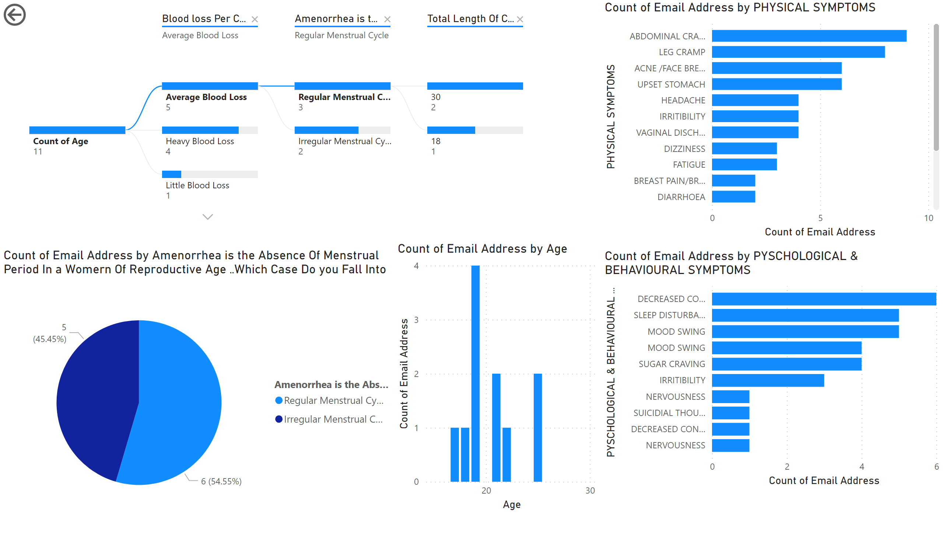
Page 1
Notes:
decompositionTreeVisual
No alt text provided
pieChart
No alt text provided
actionButton
No alt text provided
barChart
No alt text provided
clusteredBarChart
No alt text provided
columnChart
No alt text provided

Slide 3
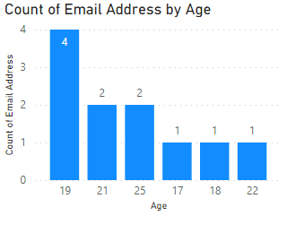
Page 2
Notes:
columnChart
No alt text provided

Slide 4

Page 3
Notes:
multiRowCard
No alt text provided
actionButton
No alt text provided

